Slide 1
1.5.3 Walkthrough #1
radius_changer.py position_changer.py
Computer Science and Software Engineering
© 2014 Project Lead The Way, Inc.

Slide 2
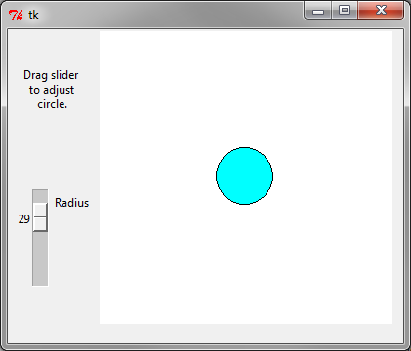
Demo: radius_changer.py
Notes:
Here we create a Canvas and draw one item on it. The coordinates of the oval item use global variables. We don’t have to say they’re global because this command is being executed in the module’s (file’s) namespace.
The code for updating the view is in the controller’s handler, radius changed. To properly follow MVC, we should separate these concerns. The controller has no business reaching into the canvas! The controller should ask the view to change the radius. Or, more properly, if we were following the MVC pattern, the controller should subscribe to updates from the model, and the model should tell the view to update. For getting something small done with Tkinter, this suffices. As code gets big and complicated, we might wish we had separated the concerns and created independent Model, View, and Controller classes.

Slide 3
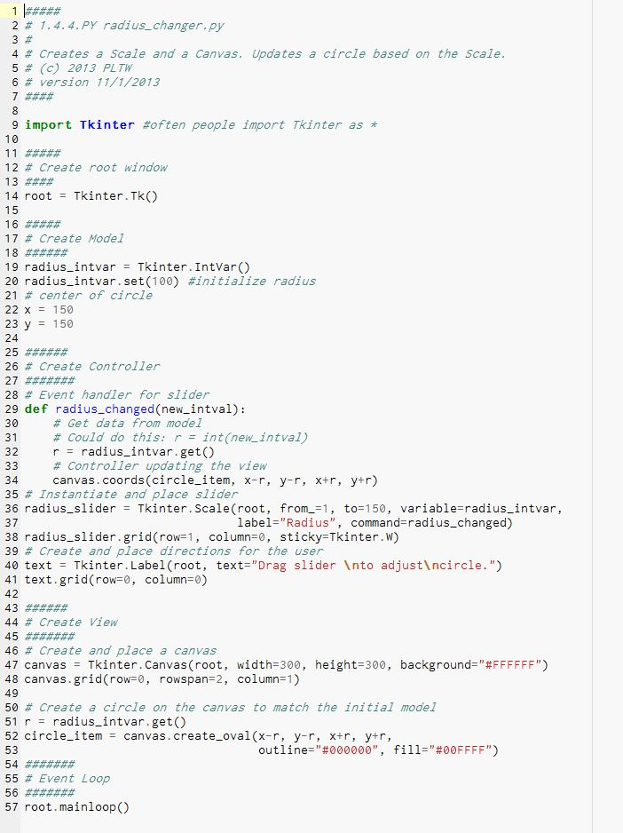
Header
Notes:
The header contains meta data about the file.

Slide 4
Initialize
Notes:
We will have to use “Tkinter” before class constructors and constants from the class. To avoid this, people sometimes use
from Tkinter import *
like we did in the tutorial example.
Line 14 creates a Tk top level window.

Slide 5
Model
Notes:
This IntVar will be used by a slider. We start the slider at 100. The x and y variables will hold data for a circle center. Really, these data are held by canvas, but we are creating additional variables to be able to remember them ourselves.

Slide 6
Controller
Notes:
Here we define an event handler and create a Scale attached to that handler.
The handler gets a value from the model and applies it to the view; more on that on the next slide.
Then in lines 40-41, we create a Label. Label widgets are just for short bits of text, unlike a Text widget, which is more of an editor window.

Slide 7
View
Notes:
Here we create a Canvas and draw one item on it. The coordinates of the oval item use global variables. We don’t have to say they’re global, because this command is being executed in the module’s (file’s) namespace.
The code for updating the view is in the controller’s handler, radius changed. To properly follow MVC, we should separate these concerns. The controller has no business reaching into the canvas! The controller should ask the view to change the radius. Or, more properly, if we were following the MVC pattern, the controller should subscribe to updates from the model, and the model should tell the view to update. For a few hundred lines with Tkinter, this is still great. As code gets big and complicated, though, we might wish we had separated the concerns and created independent Model, View, and Controller classes.

Slide 8
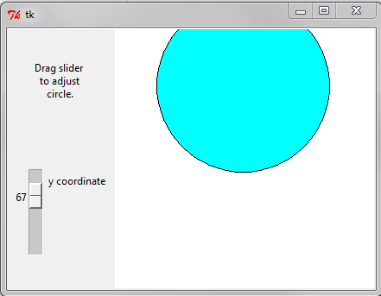
Demo: position_changer.py
Notes:
Your teacher will demonstrate the position_changer.py program, and then you will create it.

